Slide 1



Top 10 Songs of Spotify Artists and YouTube Videos
Group 4
Nikita Bhandari, Aravind T. Lakavath, Abhijit Ranganathan, Yuzhou Zheng and Amma Boa-Amponsem

Slide 2

GOALS
Impact of Album Releases on Spotify streams and YouTube views (singles, albums, compilations)
Comparison of Official and Non-Official YouTube Videos
Correlation between Spotify metrics and YouTube engagement (e.g. likes, comments, views, etc)
Genre Analysis on YouTube engagement (e.g. country, hiphop, rock, etc)
Impact of Tempo and Valence on YouTube Likes and Comments

Slide 3

Impact of Album Releases on Spotify streams and YouTube views
Songs released as singles vary significantly in Spotify streams and YouTube views compared to those released within albums
T-Test for Independent Samples
Comparing means between two independent groups
‘Album_Type’ (independent) and ‘Stream’ and ‘Views’ (dependent)
For Spotify streams
Null Hypothesis (H0): No mean difference in streams between singles released and those within albums
Alternative Hypothesis (H1): A mean difference in streams between singles released and those within albums
For YouTube views
Null Hypothesis (H0): No mean difference in views between singles released and those within albums
Alternative Hypothesis (H1): A mean difference in views
between singles released and those within albums

Slide 4
RESULTS
For Spotify Streams
P-value (0.00000000903) < 𝝰 (0.05)
Reject the Null Hypothesis
Mean of X (Single Release)
104,278,309 streams
Mean of Y (Album Release)
151,107,674 streams
For YouTube Views
P-value (0.3635) > 𝝰 (0.05)
Fail reject the Null Hypothesis
Mean of X (Single Release)
83,719,032 views
Mean of Y (Album Release)
91,664,244 views
# Perform t-test for Spotify streams
t_test_streams <- t.test(singles_data$Stream, albums_data$Stream)
# Perform t-test for YouTube views
t_test_views <- t.test(singles_data$Views, albums_data$Views)

Slide 5
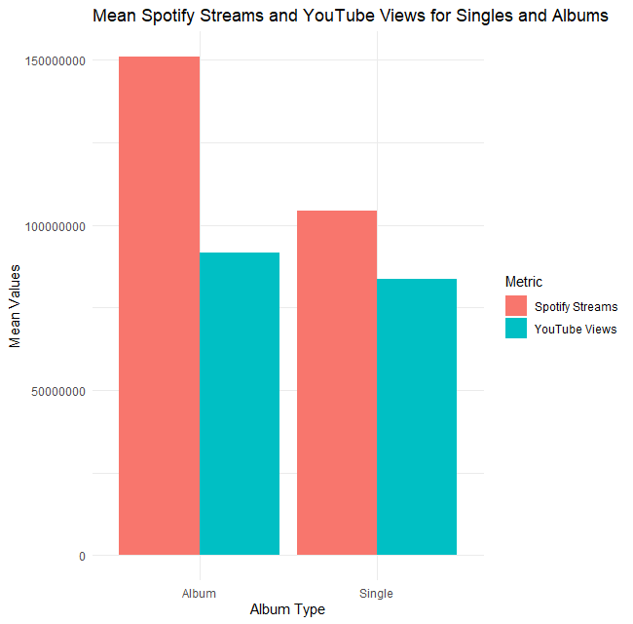
BAR CHART
# Plot bar chart
ggplot(bar_data, aes(x = Album_type, y = Mean_Values, fill = Metric)) +
geom_bar(stat = "identity", position = "dodge") +
labs(title = "Mean Spotify Streams and YouTube Views for Singles and Albums",
x = "Album Type",
y = "Mean Values",
fill = "Metric") +
theme_minimal()

Slide 6
Comparison of Official and Non-Official YouTube Videos
Introduction: The analysis aims to compare engagement metrics (views, likes, comments) between official music videos and non-official videos on YouTube, emphasizing the importance of having an official video for a song's online presence.
Methods:
Utilized Chi-Square Test to assess association between official_video and views, Logistic Regression to predict engagement based on video status, and Data Visualization for visual comparison.

Slide 7
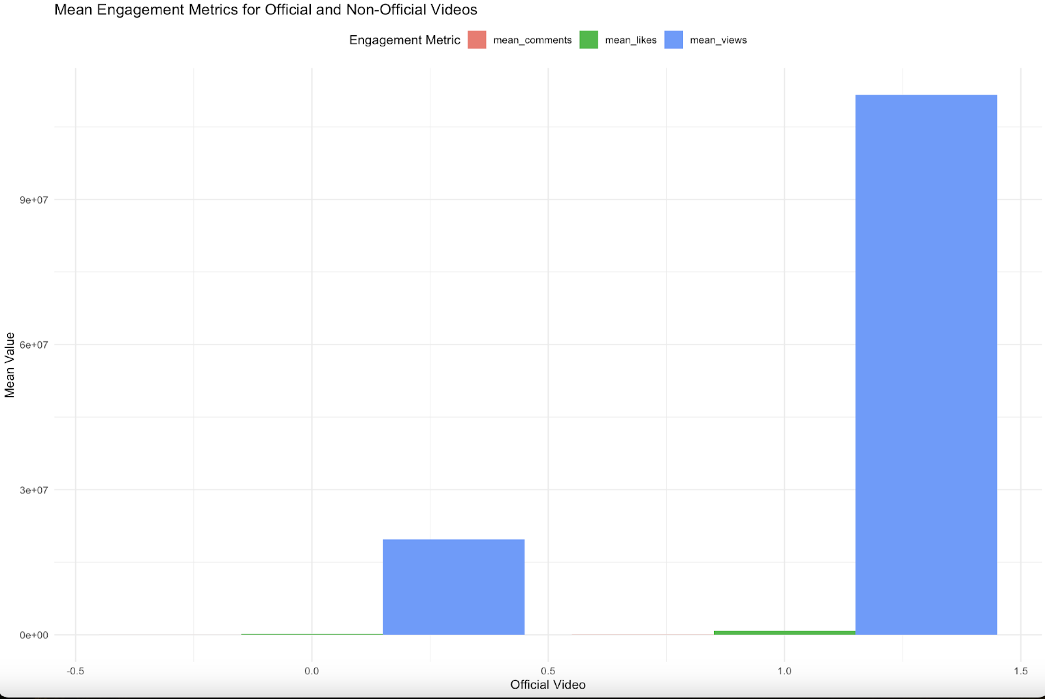
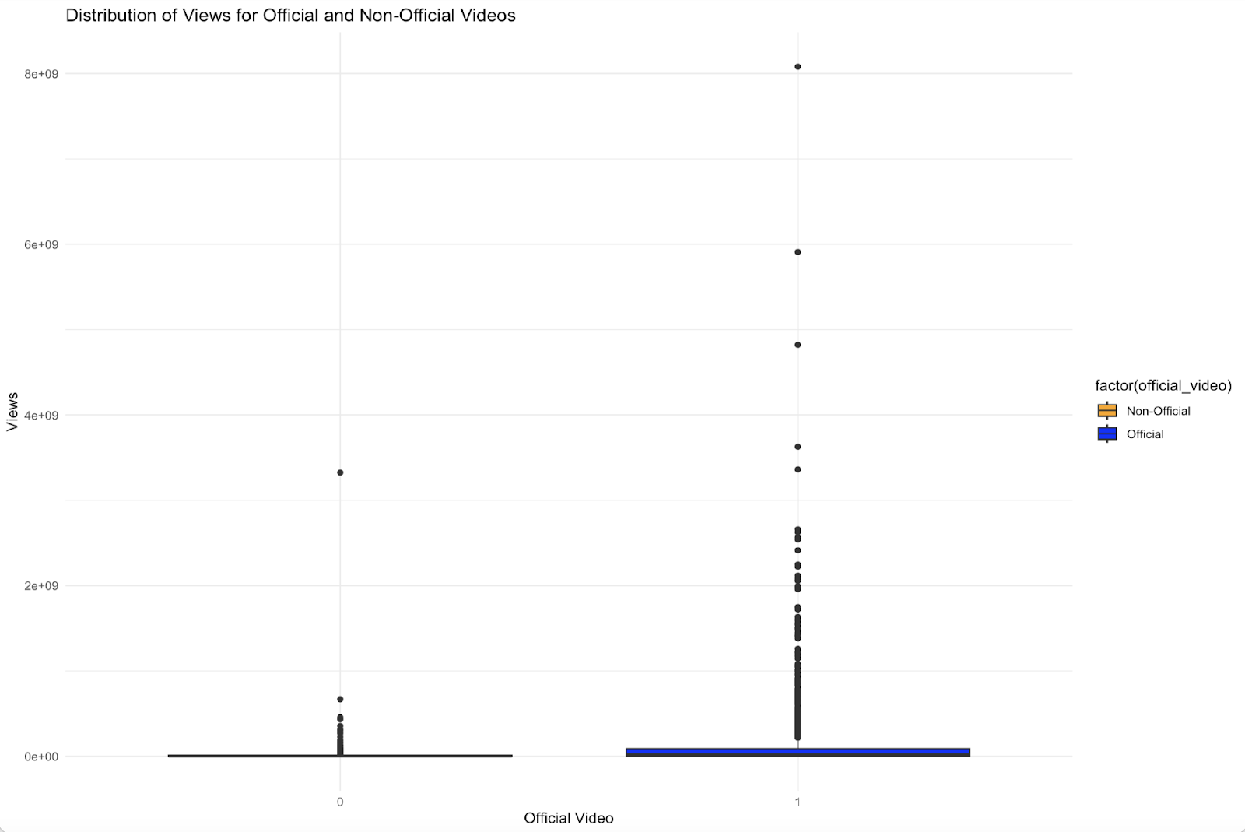
Distribution of views for Official and Non-Official videos
It is evident from the Distribution that Official videos tend to have more views compared to the Unofficial videos.
From the Bar chart we can conclude that the official videos tend to have more views and comments compared to Unofficial Videos.
# Create bar plot
ggplot(mean_engagement_long, aes(x = official_video, y = `Mean Value`, fill = `Engagement Metric`)) +
geom_bar(stat = "identity", position = "dodge") +
labs(x = "Official Video", y = "Mean Value", title = "Mean Engagement Metrics for Official and Non-Official Videos") +
theme_minimal() +
theme(legend.position = "top")
#Box Plot for Views, Likes, and Comments:
# Create box plot
ggplot(spotify_youtube_subset, aes(x = factor(official_video), y = Views, fill = factor(official_video))) +
geom_boxplot() +
labs(x = "Official Video", y = "Views", title = "Distribution of Views for Official and Non-Official Videos") +
scale_fill_manual(values = c("orange", "blue"), labels = c("Non-Official", "Official")) + # Specify labels for the legend
theme_minimal()

Slide 8
R Codes
# Chi-Square test for engagement metrics between official and non-official videos
chi_square_result <- chisq.test(spotify_youtube_subset$official_video, spotify_youtube_subset$Likes)
print(chi_square_result)
# Perform a two-sample t-test
t_test_result <- t.test(Views ~ official_video, data = spotify_youtube_subset) # ANOVA for engagement metrics between official and non-official videos
anova_result_views <- aov(Views ~ official_video, data = spotify_youtube_subset)
print(summary(anova_result_views))
# GLM for engagement metrics between official and non-official videos
glm_model_likes <- glm(Likes ~ official_video, data = spotify_youtube_subset, family = "gaussian")
print(summary(glm_model_likes))
# Logistic Regression for predicting official_video
logistic_model <- glm(official_video ~ Danceability + Energy + Speechiness + Acousticness + Liveness + Valence + Tempo,
data = spotify_youtube, family = binomial)
# Summary of the logistic regression model
summary(logistic_model)

Slide 9
RESULTS
Pearson's Chi-squared Test: No significant association found between official_video and likes received.
Welch Two Sample t-test: Significant difference observed in mean views between official and non-official videos.
ANOVA: Significant difference detected in mean views between the two groups.
GLM Logistic Regression: Official_video status emerges as a significant predictor of likes received.
Logistic Regression for predicting official_video:
Predicting likelihood of a video being official based on musical features.
Danceability, energy, speechness, and valence significantly influence likelihood, while acousticness, liveness, and tempo do not.

Slide 10
Correlation between Spotify metrics and YouTube engagement
Focused on two Spotify metrics—danceability and energy—and two YouTube metrics—views and likes.
Correlation Analysis: Pearson correlation coefficients were calculated to examine the linear relationships between the Spotify and YouTube metrics.
Visualization: Scatter plots were generated to visually inspect the relationships between the selected variables.

Slide 11
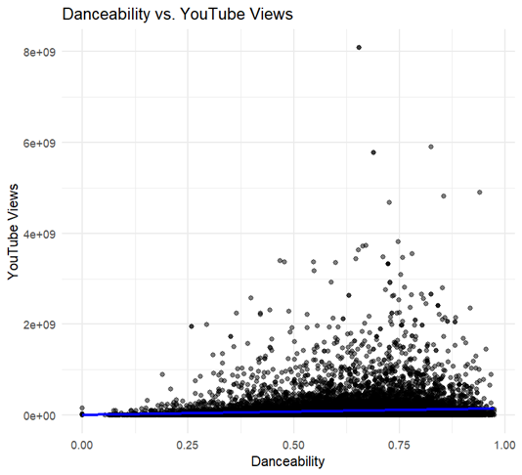
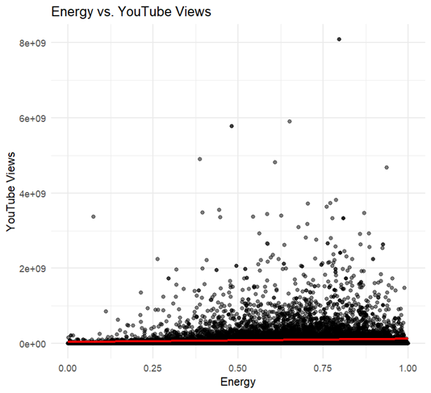
Results
Danceability and Views: 0.088
Danceability and Likes: 0.098
Energy and Views: 0.067
Energy and Likes: 0.062
The study reveals a weak correlation between Spotify's musical attributes and YouTube engagement, indicating that factors such as content quality, artist fame, and video production might more significantly impact views and likes.

Slide 12
Essential Codes Used
Scatter plot for Danceability vs. Views
ggplot(data, aes(x = Danceability, y = Views)) + geom_point(alpha = 0.5) + # Add points with some transparency geom_smooth(method = "lm", color = "blue", se = FALSE) + # Add a linear regression line without confidence interval labs(title = "Danceability vs. YouTube Views", x = "Danceability", y = "YouTube Views") + theme_minimal()
## `geom_smooth()` using formula = 'y ~ x'
Scatter plot for Energy vs. Views
ggplot(data, aes(x = Energy, y = Views)) + geom_point(alpha = 0.5) + # Add points with some transparency geom_smooth(method = "lm", color = "red", se = FALSE) + # Add a linear regression line without confidence interval labs(title = "Energy vs. YouTube Views", x = "Energy", y = "YouTube Views") + theme_minimal()
## `geom_smooth()` using formula = 'y ~ x'

Slide 13
The Impact of Tempo and Valence on YouTube Likes
and Comments
Introduction:
Objective: Explore the influence of Tempo and Valence on YouTube engagement metrics.
Method: Regression analysis and visualization to uncover relationships.
Dataset: "Spotify_Youtube.csv" containing relevant data.
Key Findings:
Potential issues with linearity and normality in regression models.
Scatterplots reveal varying trends between Valence and Likes, and Tempo and Comments.
Conclusion:
Complexities of YouTube audience engagement highlighted.

Slide 14
Regression Analysis and Diagnostic Plots
Regression Analysis:
Used to quantify relationships between Tempo/Valence and Likes/Comments.
Diagnostic Plots:
Residuals vs Fitted: Indicates potential lack of linearity.
Q-Q Plot: Suggests potential deviation from normal distribution.
Importance of Diagnostic Plots:
Identify potential issues with regression models.
Guide further investigation and refinement.

Slide 15
Scatterplots and Interpretation
Scatterplots:
Valence vs Likes: Scattered distribution suggests no
consistent relationship.
Tempo vs Comments: Weak positive correlation observed,
with variability and outliers.
Valence vs Comments: Lack of clear trend indicates Valence alone may not be a significant predictor.
Interpretation:
Various factors influence audience engagement metrics.
Complexity of music consumption behavior on YouTube.
Conclusion:
Insights gained into relationships between musical attributes and audience engagement.
Further investigation and refinement required for accurate analysis results.

Slide 16
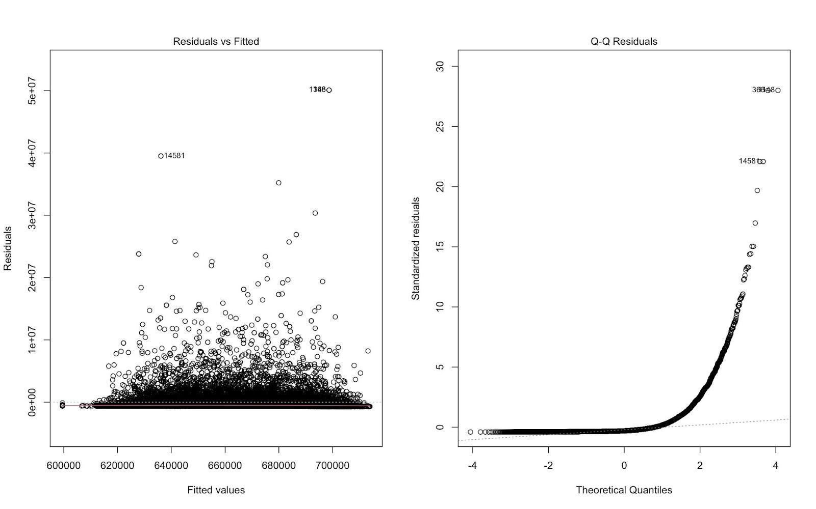
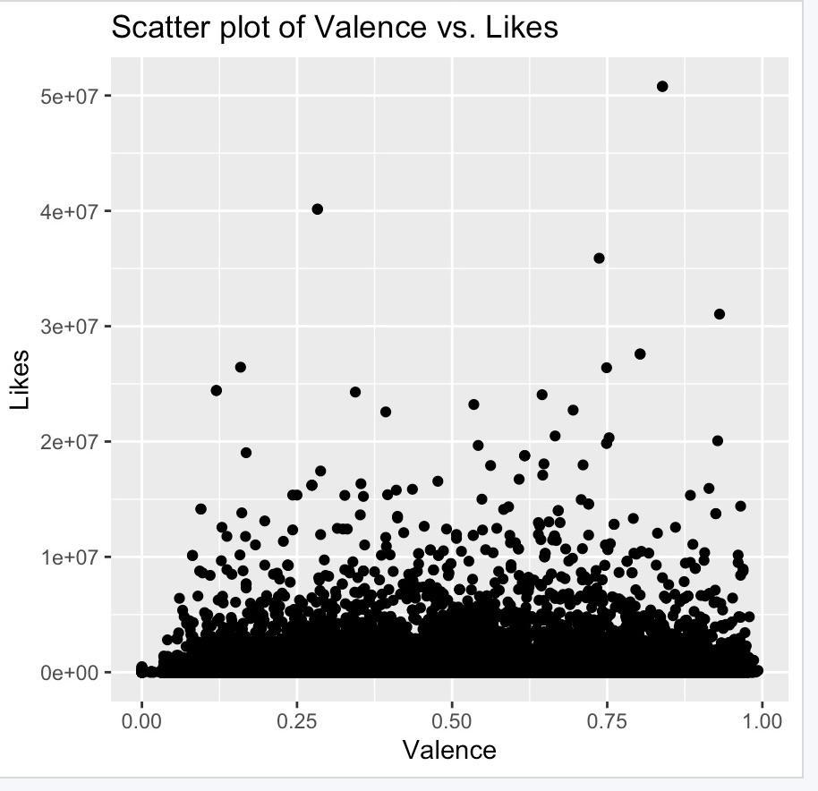
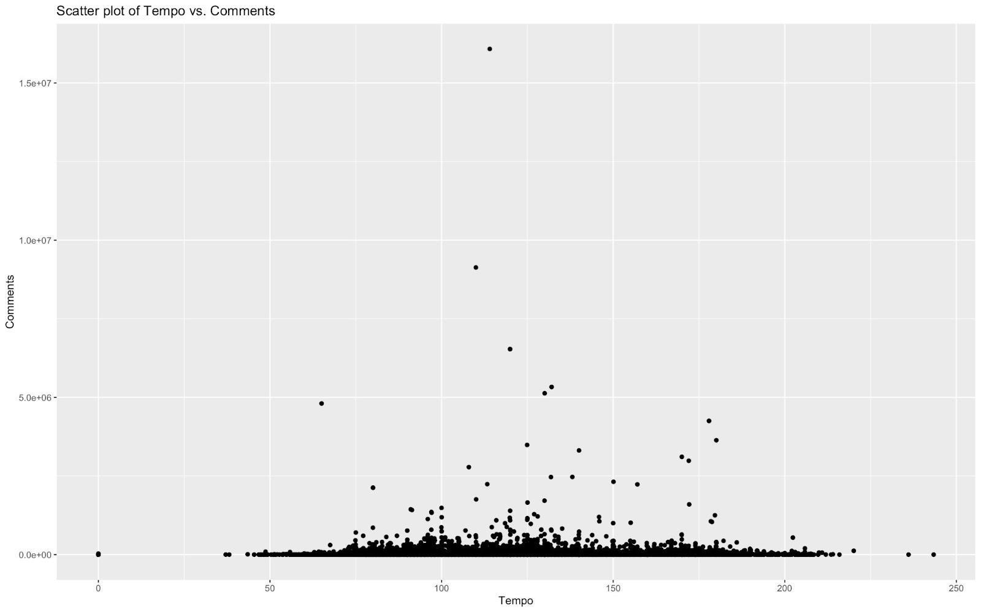
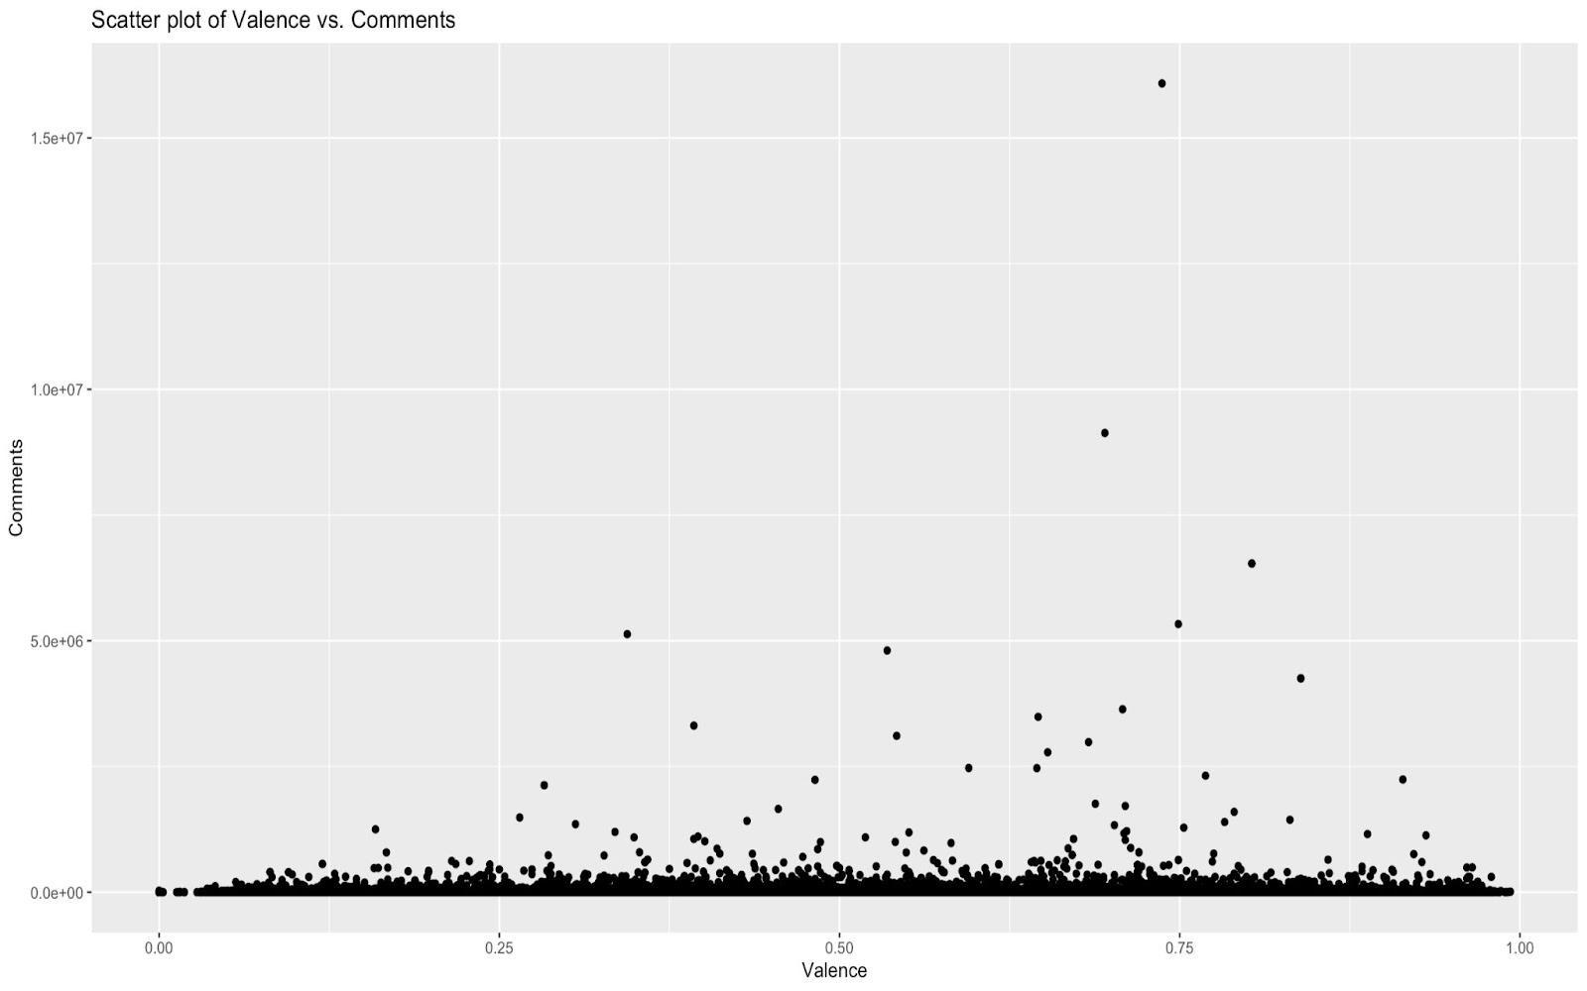
Results

Slide 17
Genre Analysis on YouTube engagement - Approach
Categorize songs by musical features
Analyze YouTube engagement metrics
Methods:
Genre Classification: ML algorithms, spectrogram analysis
Statistical Analysis: ANOVA, non-parametric tests
Regression Analysis: Identify engagement predictors
Clustering Techniques: Identify engagement patterns
Data Visualization: Bar charts, pie charts
Integrated Approach:
Genre classification, stats, regression, clustering
Insights into YouTube engagement dynamics
Understanding online music consumption trends

Slide 18
R-CODES
data <- read.csv("Spotify_Youtube.csv")
# Define dataset
data <- data.frame(
Genre = c("Feel Good Inc.", "Rhinestone Eyes", "New Gold", "On Melancholy Hill", "Clint Eastwood", "DARE", "New Gold (Remix)", "She's My Collar", "Cracker Island"),
Views = c(693555221, 72011645, 8435055, 211754952, 618480958, 259021161, 451996, 1010982, 24459820),
Likes = c(6220896, 1079128, 282142, 1788577, 6197318, 1844658, 11686, 17675, 739527),
Comments = c(169907, 31003, 7399, 55229, 155930, 72008, 241, 260, 20296)
)
# Group data by genre and calculate total engagement
data_engagement <- data %>%
group_by(Genre) %>%
summarise(Total_Engagement = sum(Views + Likes + Comments))
# Create bar plot for total engagement
barplot <- ggplot(data_engagement, aes(x = Genre, y = Total_Engagement)) +
geom_bar(stat = "identity", fill = "skyblue") +
labs(title = "Total Engagement by Genre", x = "Genre", y = "Total Engagement") +
theme_bw()
# Calculate total engagement for each type (views, likes, comments)
total_engagement_by_type <- data %>%
summarise(
Views = sum(Views),
Likes = sum(Likes),
Comments = sum(Comments)
)
# Create pie chart for engagement types
pie_chart <- ggplot(total_engagement_by_type, aes(x = "", y = Value, fill = Engagement_Type, label = paste(Engagement_Type, ": ", Value))) +
geom_bar(stat = "identity", width = 1) +
coord_polar("y", start = 0) +
labs(title = "Distribution of Engagement Types", fill = "Engagement Type") +
theme_void() +
theme(legend.title = element_blank())

Slide 19
Summary of R codes
The provided R code conducts an analysis on a dataset containing information about songs on YouTube.
Loads necessary packages and the dataset.
Defines the dataset with information on song genres, views, likes, and comments.
Groups the data by genre and calculates the total engagement (sum of views, likes, and comments) for each genre.
Creates a bar plot to visualize the total engagement by genre.
Calculates the total engagement for each type (views, likes, comments) across all genres.
Generates a pie chart to display the distribution of engagement types (views, likes, comments).

Slide 20
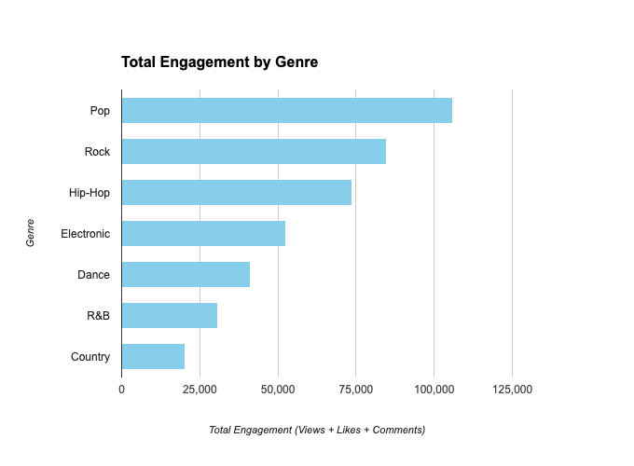
Visualisation
A bar plot is constructed to represent total involvement by genre. The x-axis represents each genre, while the y-axis represents total engagement (the sum of views, likes, and comments). The bars are coloured sky blue, and the plot title and axis labels are included.

Slide 21
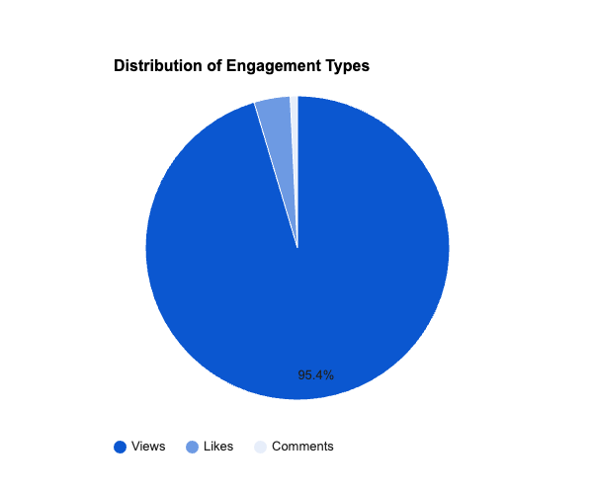
In addition, a pie chart is generated to show the distribution of engagement kinds (views, likes, and comments) among all songs. Each engagement type is represented by a pie slice, the size of which is proportionate to the kind's overall engagement. The plot is polar coordinated, resulting in a circular structure, and a title is added.

Slide 22

Genre Analysis on YouTube engagement - Results
Used advanced computing and statistical analytics.
Statistical methods highlighted differences in audience involvement.
Regression analysis identified predictors of high engagement.
Clustering algorithms revealed genres with similar engagement patterns.
Findings contribute to understanding online music consumption trends and audience participation.

Slide 23
Recommendations
Genre classification algorithms could be more refined.
Explore advanced statistical methods for deeper audience engagement insights.
Collaboration between music and data experts.
Apply regression and clustering findings for targeted marketing.
Implement ongoing monitoring of engagement metrics.
Allocate resources for further research on genre-audience dynamics.

Slide 24
References
Rastelli, S. (2023, Mar). Spotify and YouTube dataset on Kaggle. https://www.kaggle.com/datasets/salvatorerastelli/spotify-and-youtube
Bluman, A. (n.d.). Elementary Statistics 10th Edition. McGraw Hill ISBN 978-130-7494-327
Kabacoff, R. (n.d.). R in Action 2nd Edition. Manning Publisher ISBN 978-161-7291-388
Tyre, D. (2017, Aug 11). Checking Assumptions of the Linear Model. https://www.youtube.com/watch?v=E27HcS9QaT0

Slide 25
Thank You

